Slide 1

Visión por Computador
Domingo Mery
Departamento de Ciencia de la Computación
Escuela de Ingeniería
Universidad Católica de Chile
Deep Learning - Introduction

Slide 2
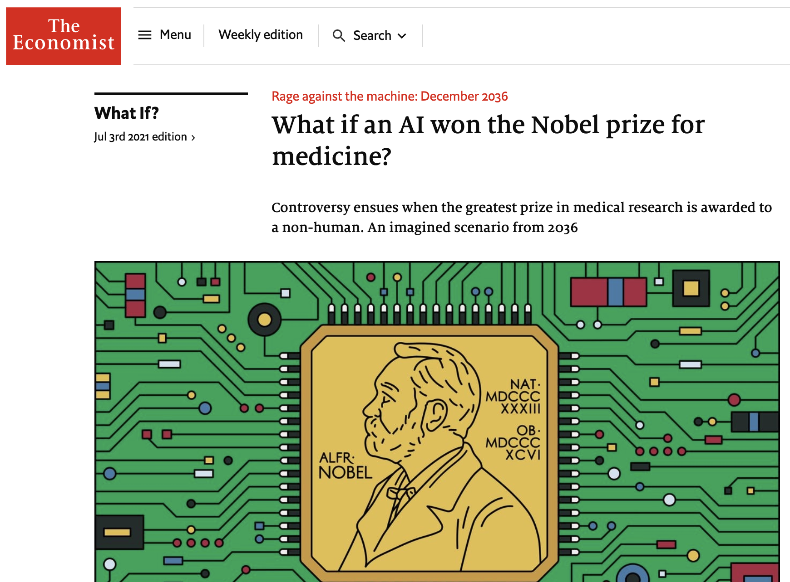
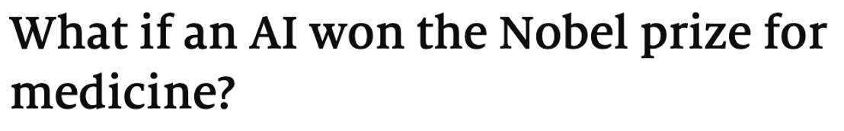
https://www.economist.com/what-if/2021/07/03/what-if-an-ai-wins-the-nobel-prize-for-medicine

Slide 3
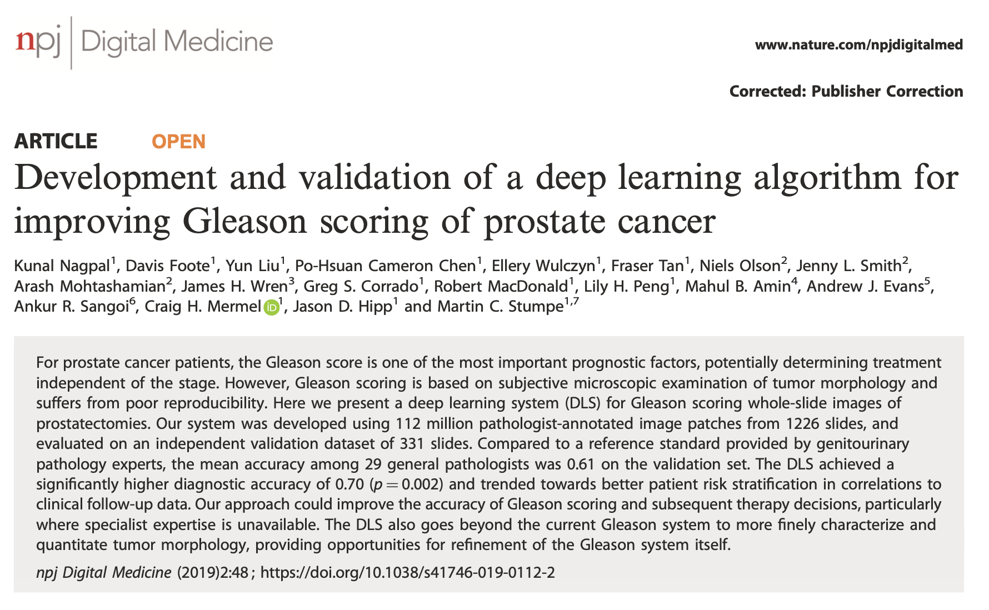

Slide 4
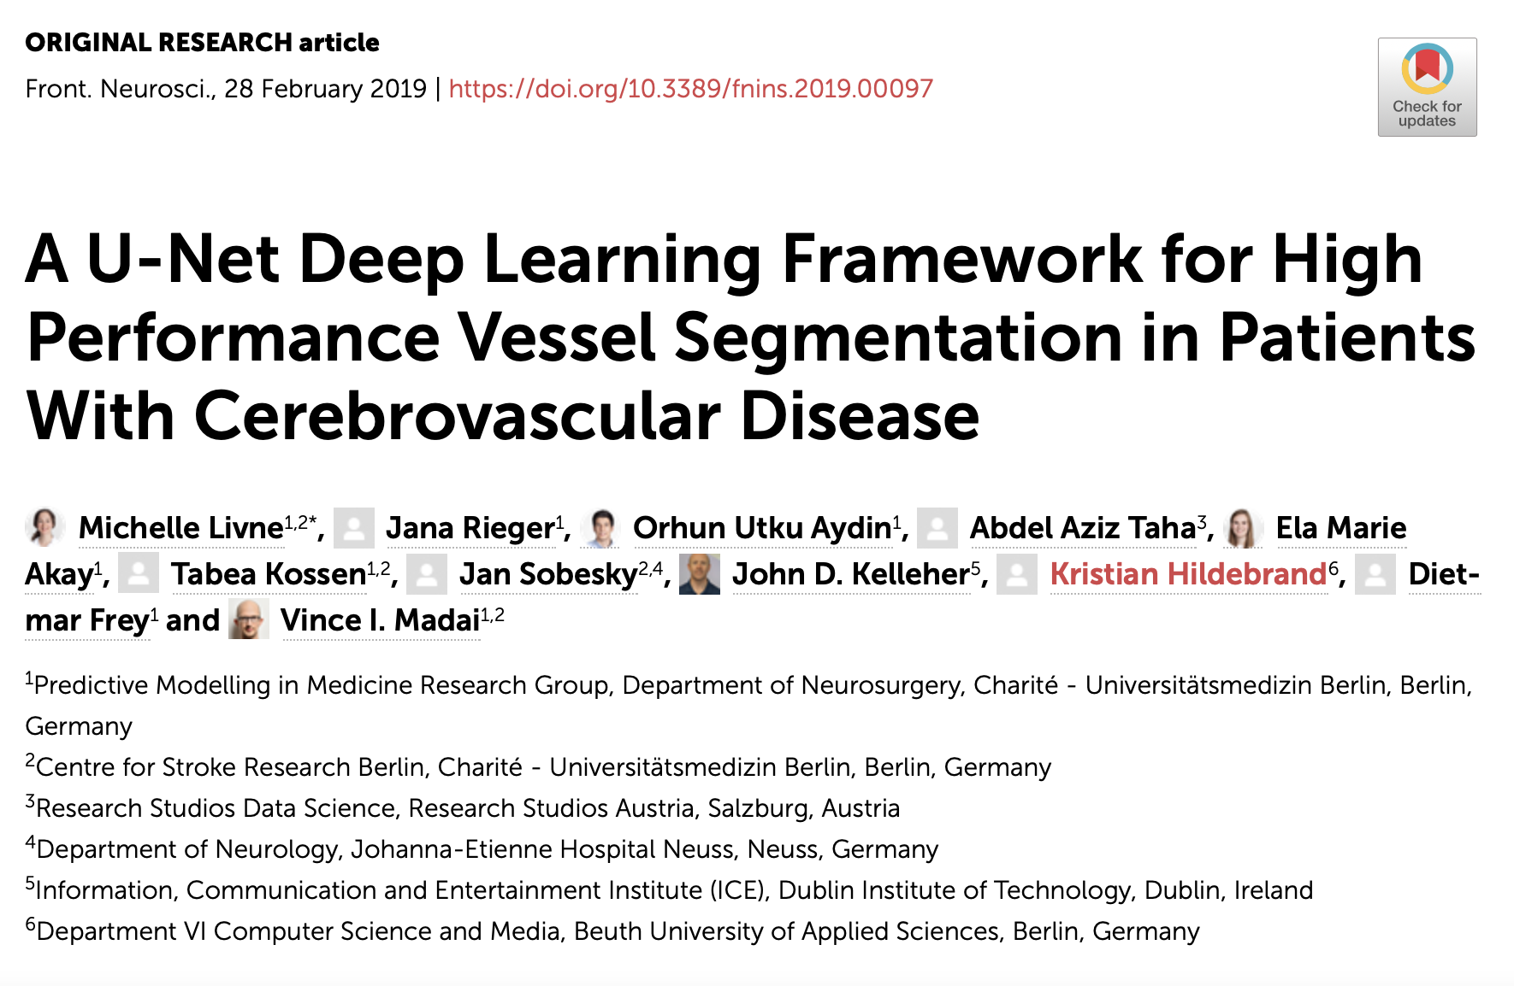
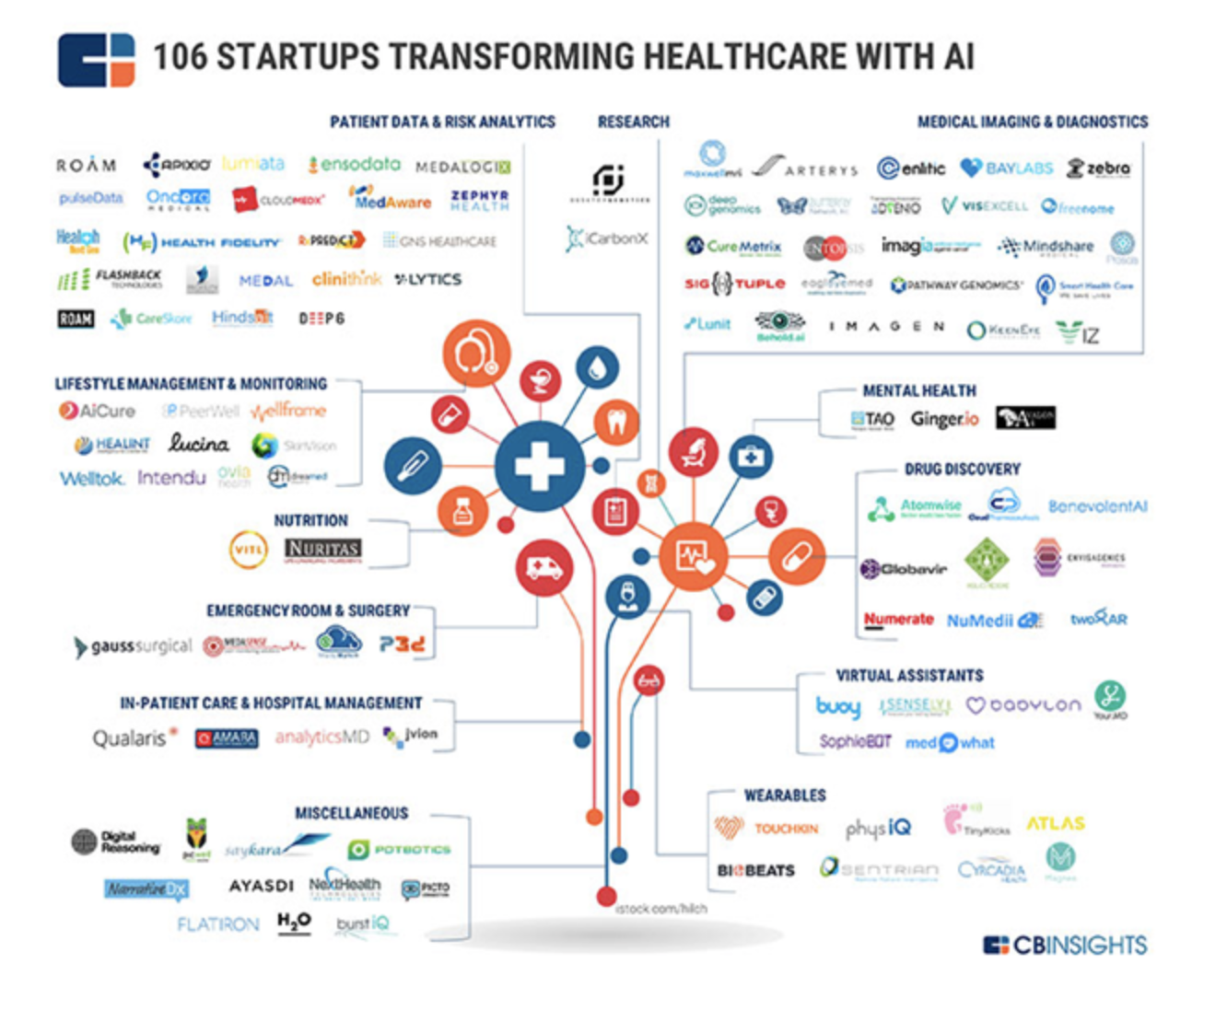
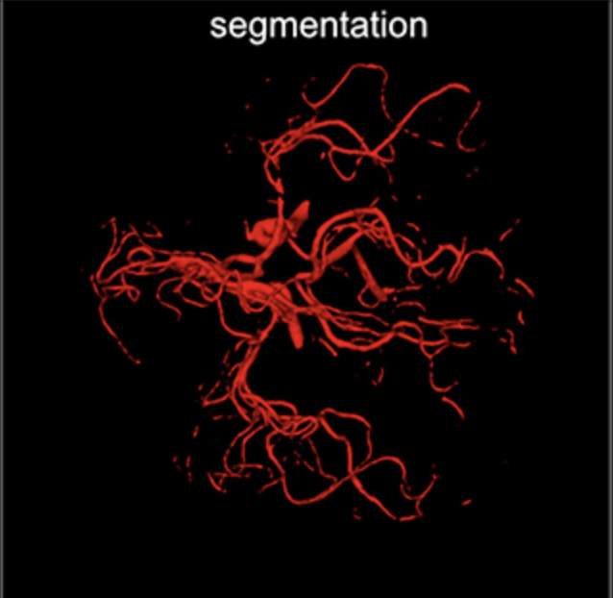

Slide 5
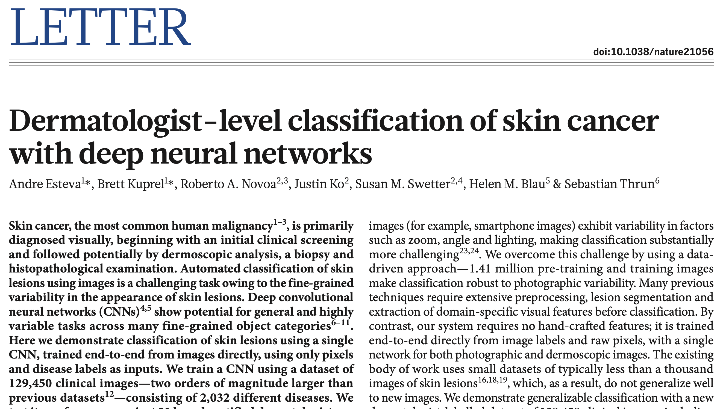

Slide 6
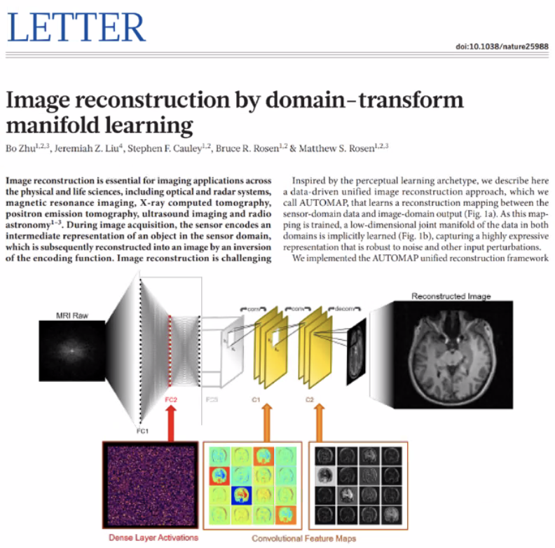

Slide 7
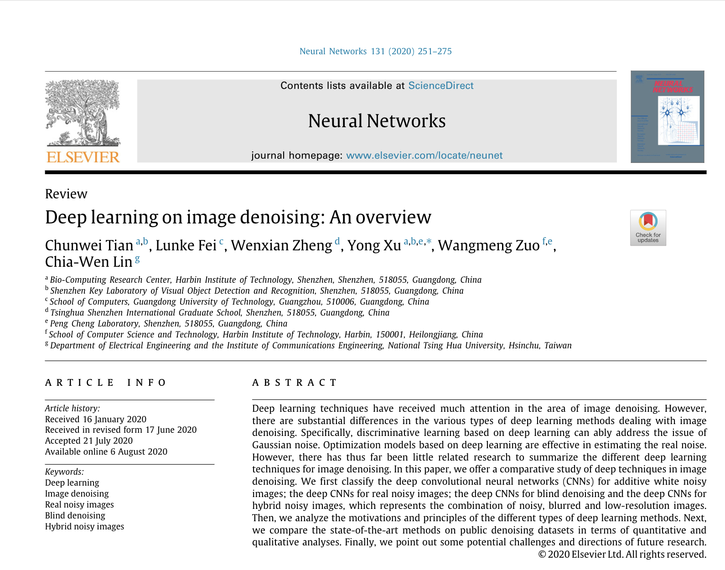

Slide 8
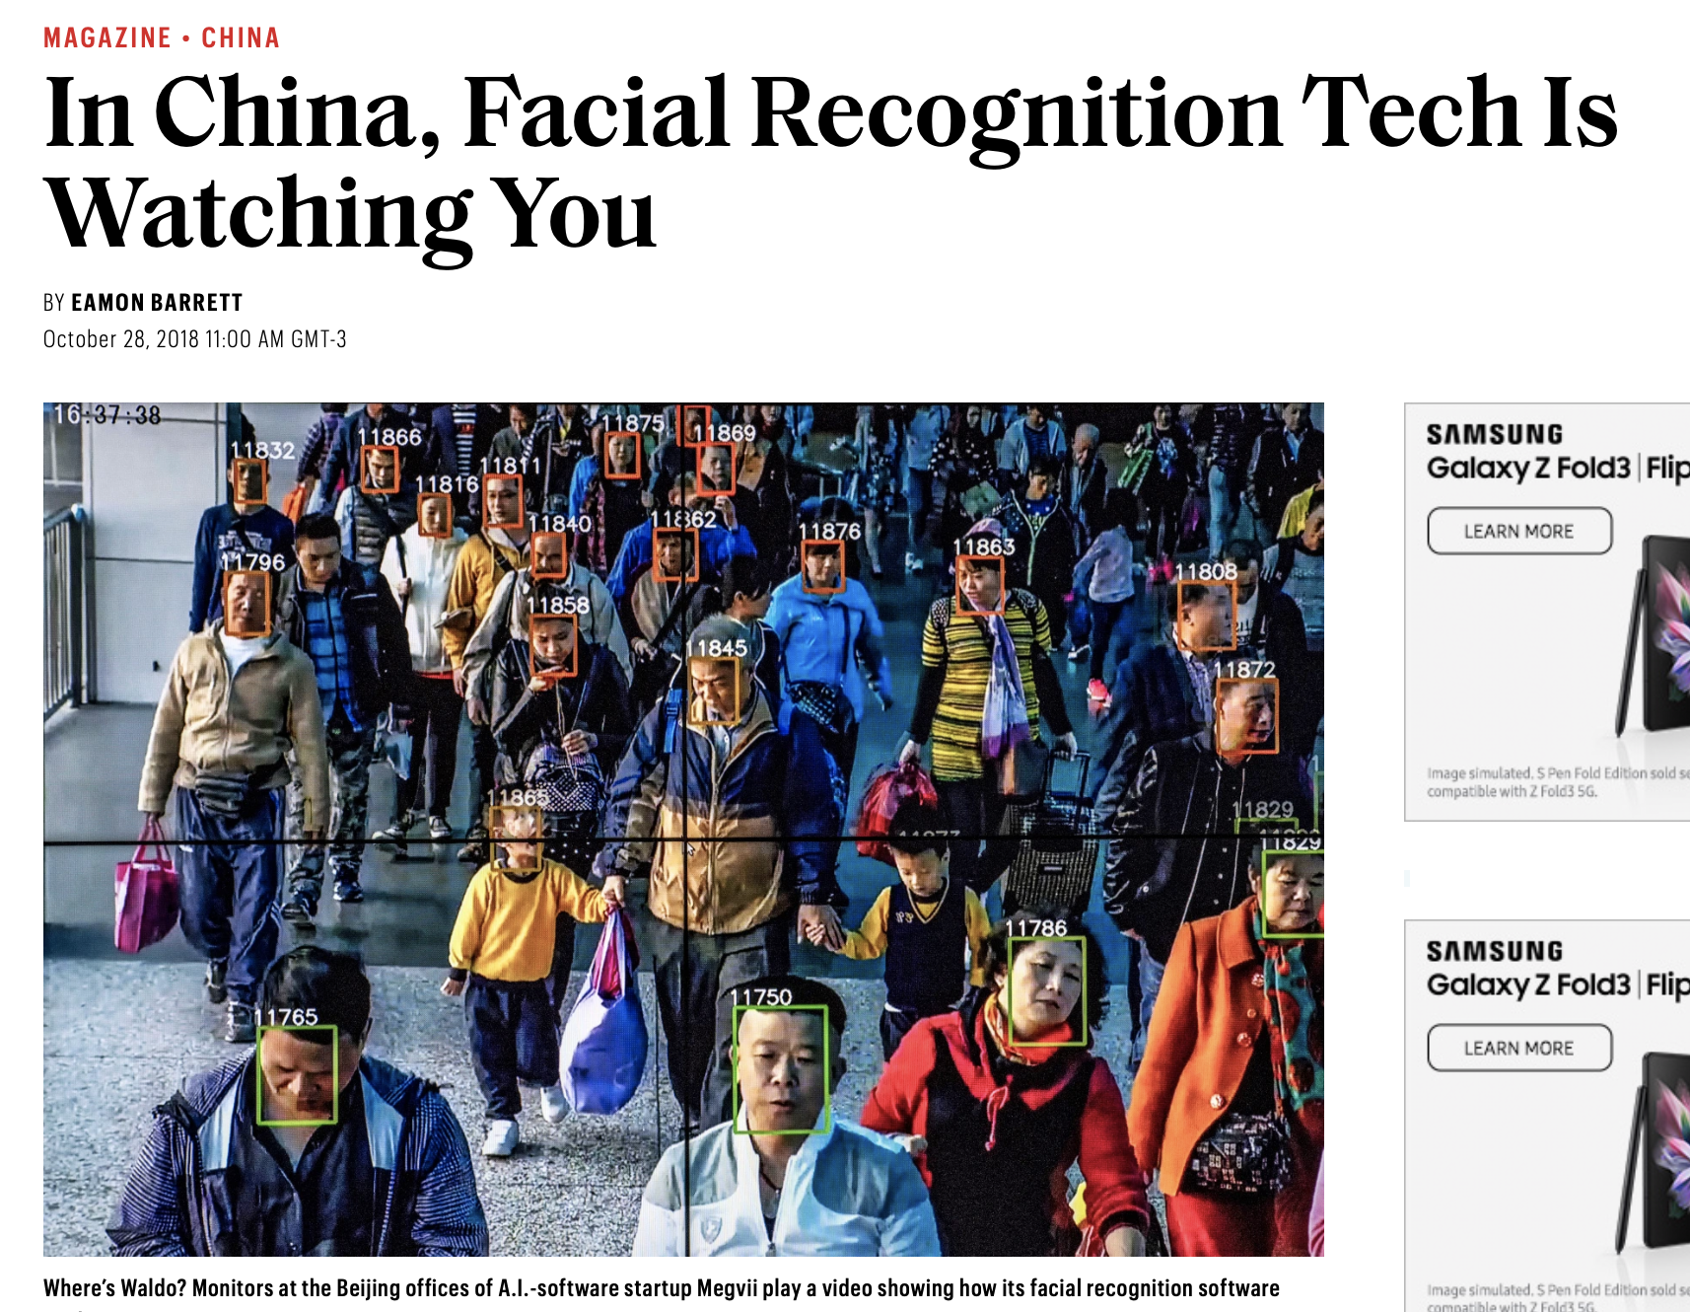

Slide 9
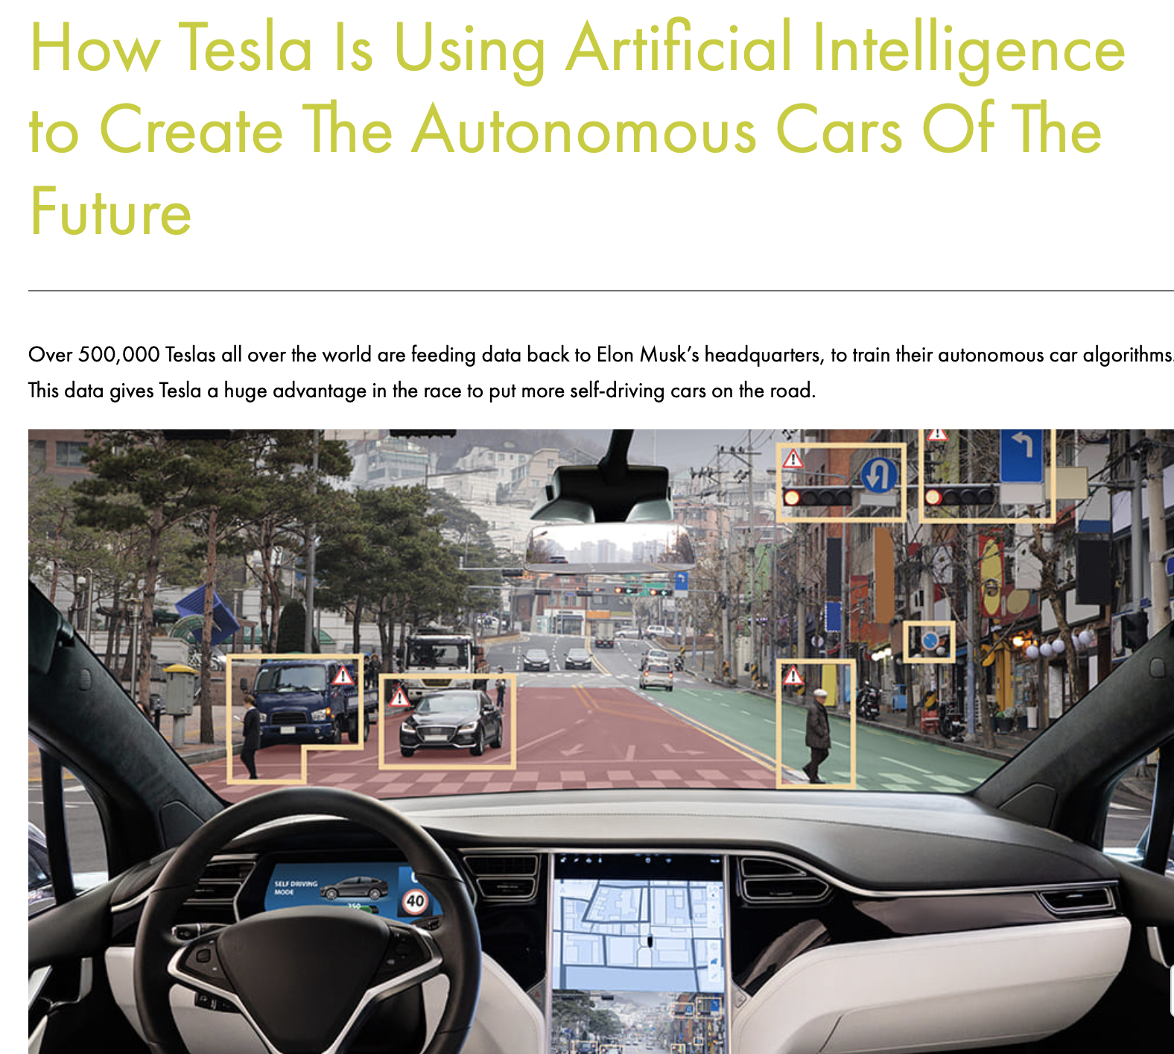

Slide 10
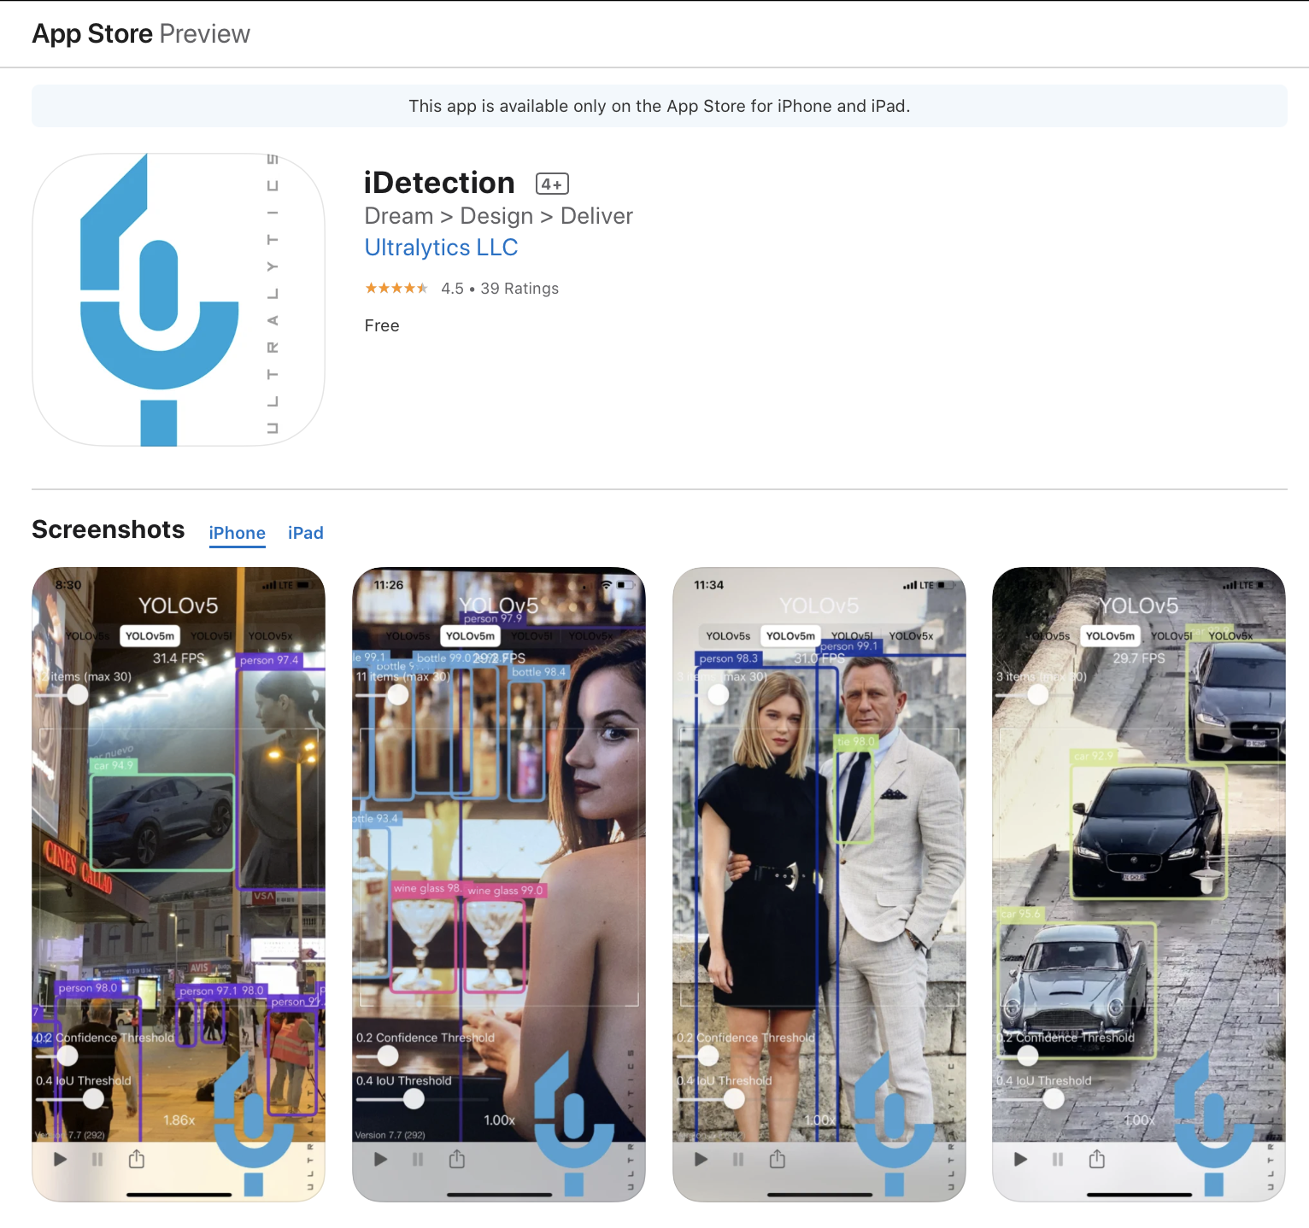
Object Detection

Slide 11

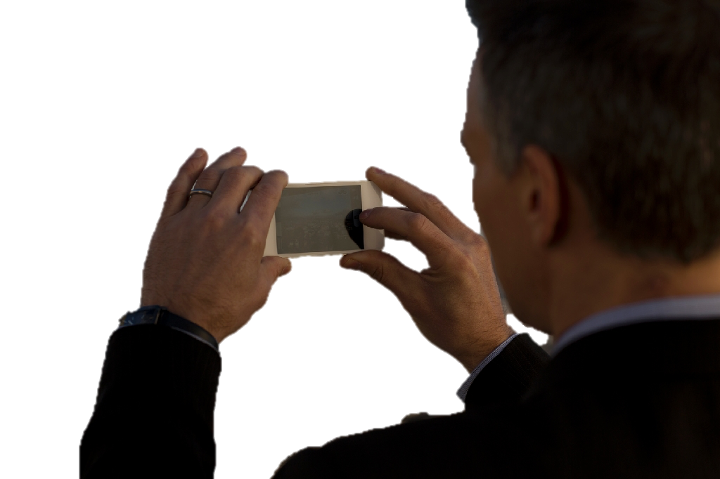
Applications: Vivino

Slide 12


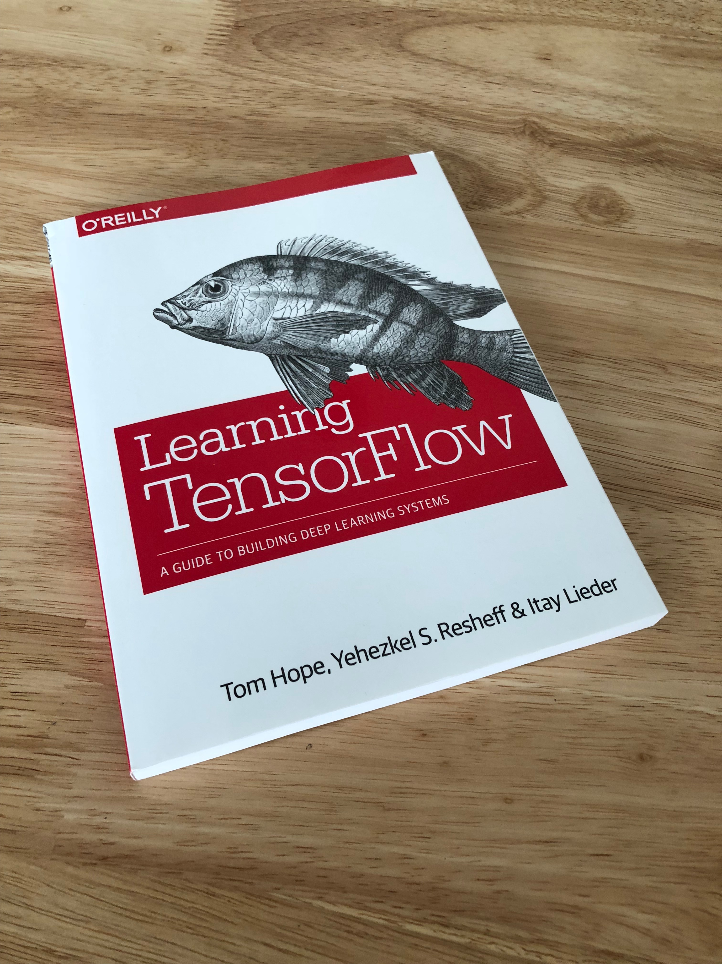
Applications: Amazon

Slide 13
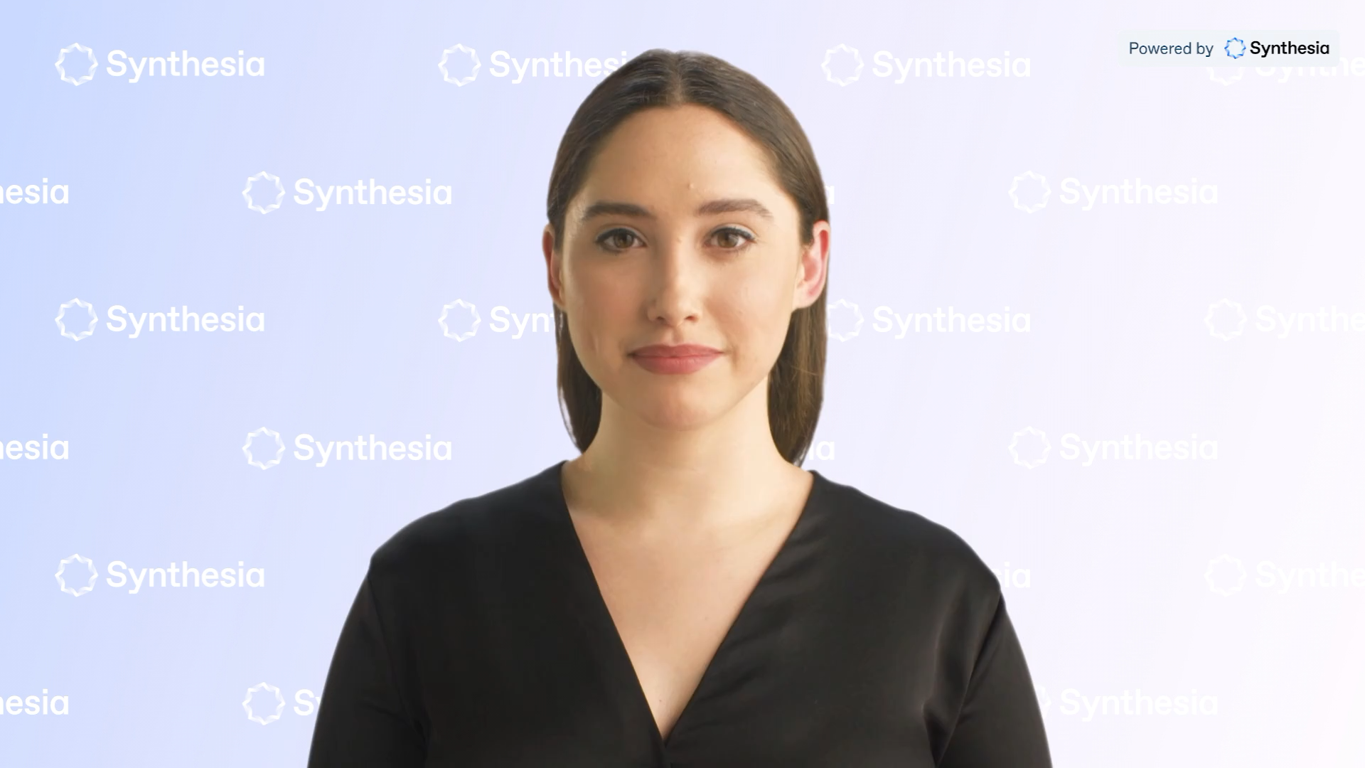

Slide 14
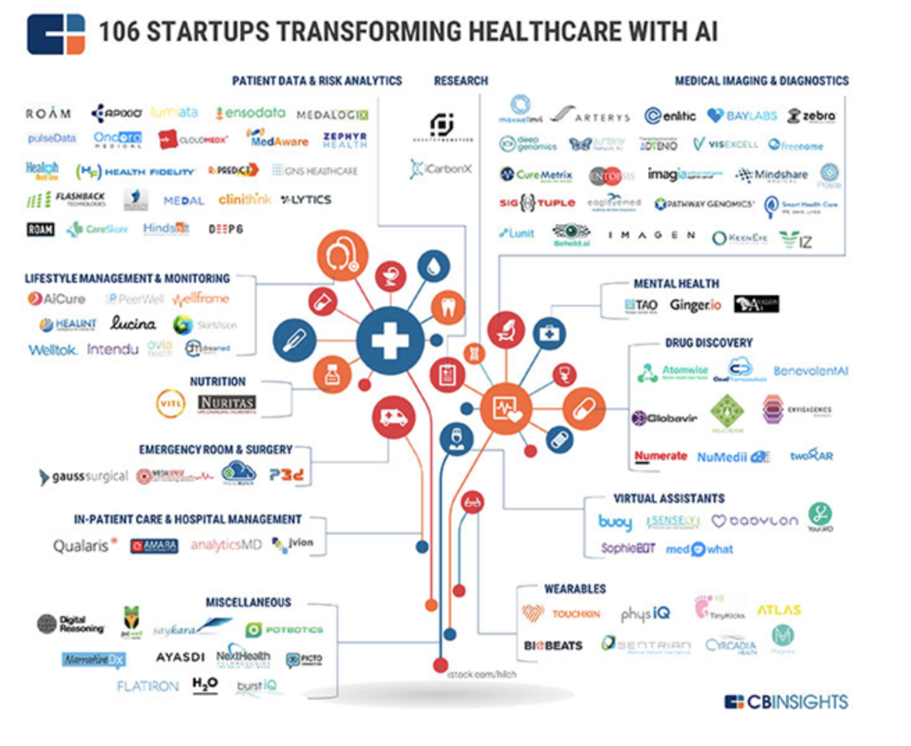

Slide 15
… etcetera
Notes:
AI is good or bad?
Ethical considerations
artificial intelligence is here to stay, and in Medicine the idea is to develop an Ai centered in human beings,
Artificial Intelligence has the potential to help us realize our shared dream of a better future for all of humanity

Slide 16

Applications of Computer Vision
Domingo Mery
X-rays and Computer Vision Lab
Department of Computer Science
Universidad Católica – Chile
http://domingomery.ing.uc.cl

Slide 17
> Five Applications of Computer Vision
Applications
Image Classification
Image Processing
Object Detection
Anomaly Detection
Human + Computer Vision
Applications of Computer Vision
Problem
Solution
Examples

Slide 18
Applications of Computer Vision
Applications
Image Classification
Image Processing
Object Detection
Anomaly Detection
Human + Computer Vision

Slide 19
Applications of Computer Vision
Applications
Image Classification
Image Processing
Object Detection
Anomaly Detection
Human + Computer Vision

Slide 20
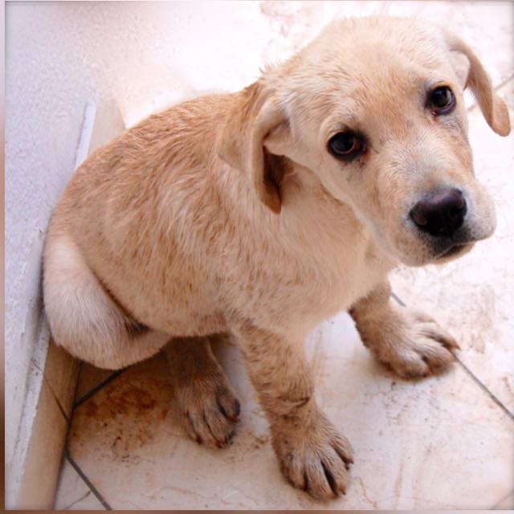
Image Classification – Problem
> Assign an image to a class or category
Image Classification
'dog’
Input: image
Output: Class

Slide 21
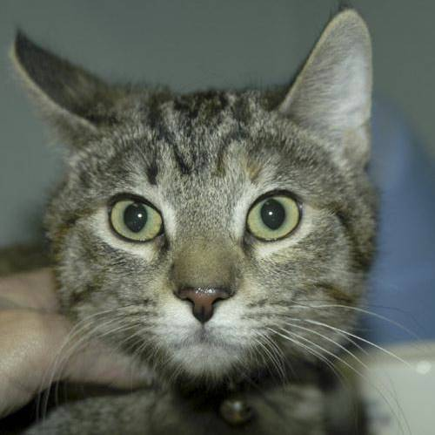
Image Classification – Problem
> Assign an image to a class or category
Image Classification
'cat’
Input: image
Output: Class

Slide 22
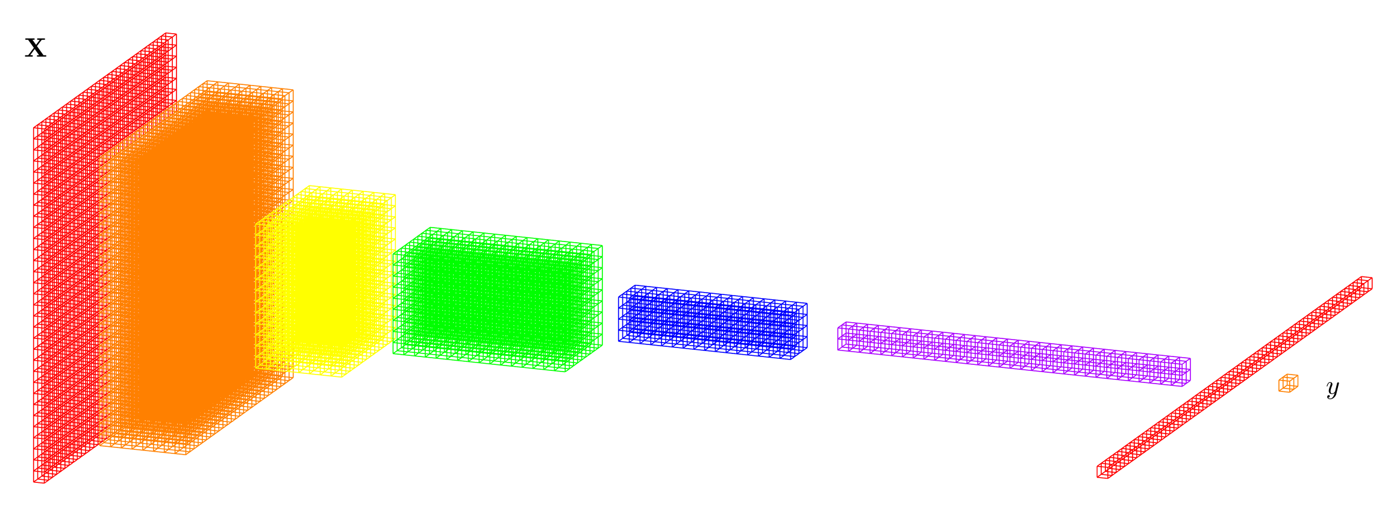

Image Classification – Solution
Deep Learning Model: CNN
Convolutional Neural Network
Layers
Output
Dog
Cat
Input image

Slide 23
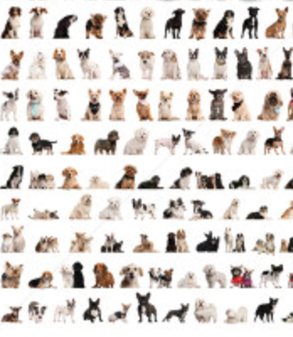


Image Classification – Solution
Deep Learning Model: CNN
Convolutional Neural Network
Dogs
errors
Cats
'dog’
Trained Model
Training Data
Back-propagation

Slide 24
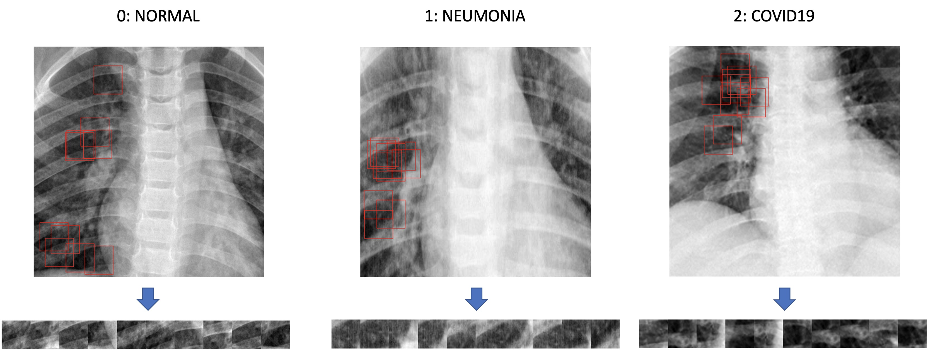
Image Classification – Example
COVID Detection with Rx
Classes →
1
2
3
4
N
N
N
N
Notes:
IDEA PRINCIPAL:
Extraer por cada radiografía N ‘ventanitas’ (patches) de las zonas oscuras.
Entrenar un clasificador que reconozca a qué clase peretenece cada patch.
Determinar a qué clase pertenece una radiografía a partir de la mayoría de votos de la clasificación individual de los patches.

Slide 25
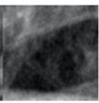
Image Classification – Example
COVID Detection with Rx
Training
CNN
15.840 patches
660 subjects*
(220 per class)
(80% training, 20% validation)
94.0% 91.7%
(*) 2 datasets: SIRM, UC
Trained
model
Testing
Image
Classification
Majority
Vote
3.640 patches
150 subjects*
(50 per class)
output
88.9%
95.3%

Slide 26
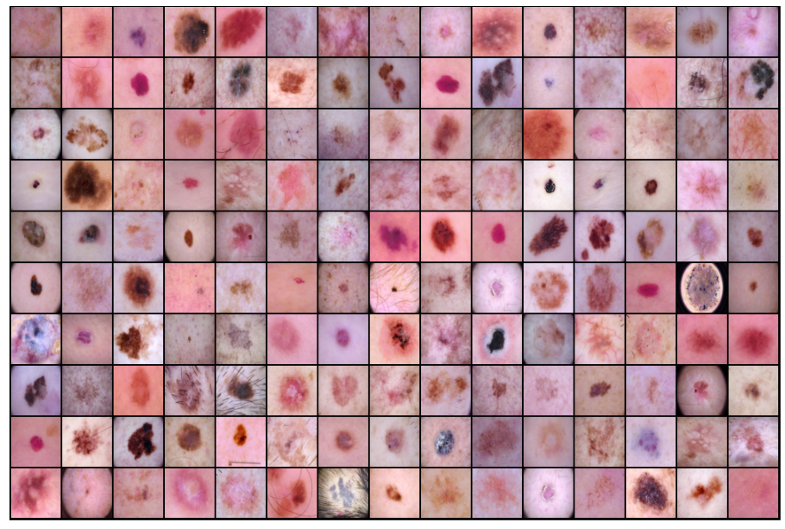
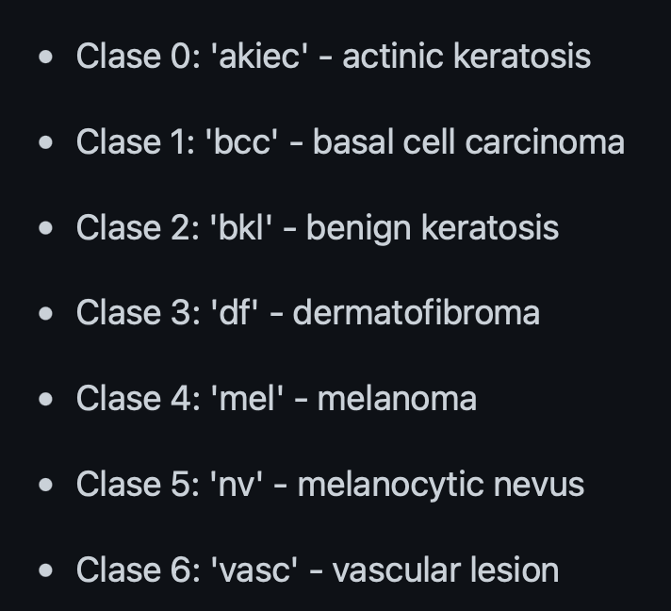
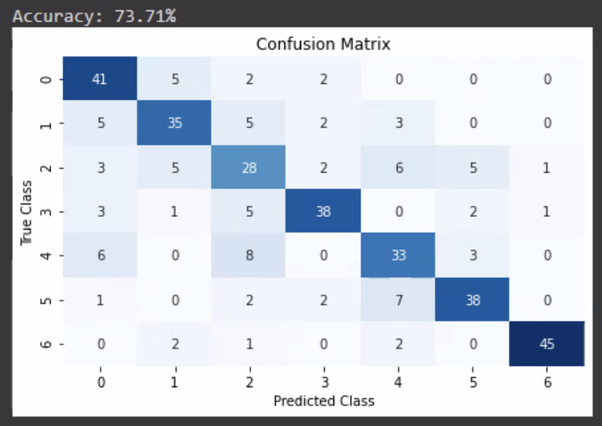
Image Classification – Example
Skin Lesion Recognition
7 classes
5000 images*
CNN
73.71%
(*) ISIC dataset

Slide 27
Applications of Computer Vision
Applications
Image Classification
Image Processing
Object Detection
Anomaly Detection
Human + Computer Vision

Slide 28
Applications of Computer Vision
Applications
Image Classification
Image Processing
Object Detection
Anomaly Detection
Human + Computer Vision

Slide 29
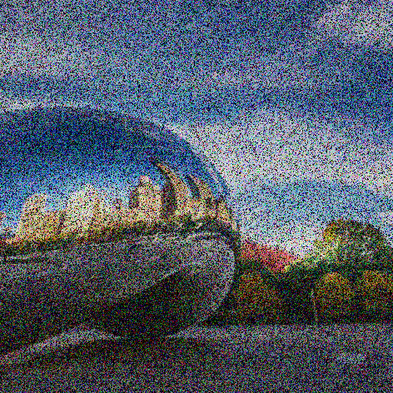
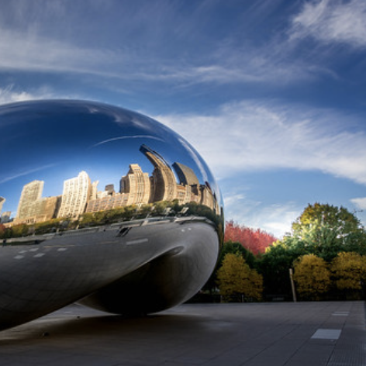
Image Processing – Problem
> Get a target output image from an input image
Image
Denoising
Input: image
Output: Filtered image

Slide 30
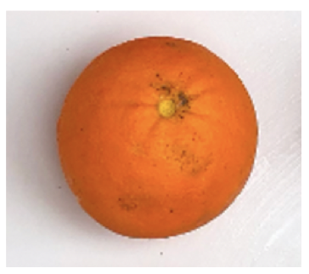

Image Processing – Problem
> Get a target output image from an input image
Image Segmentation
Input: image
Output: Segmentation

Slide 31
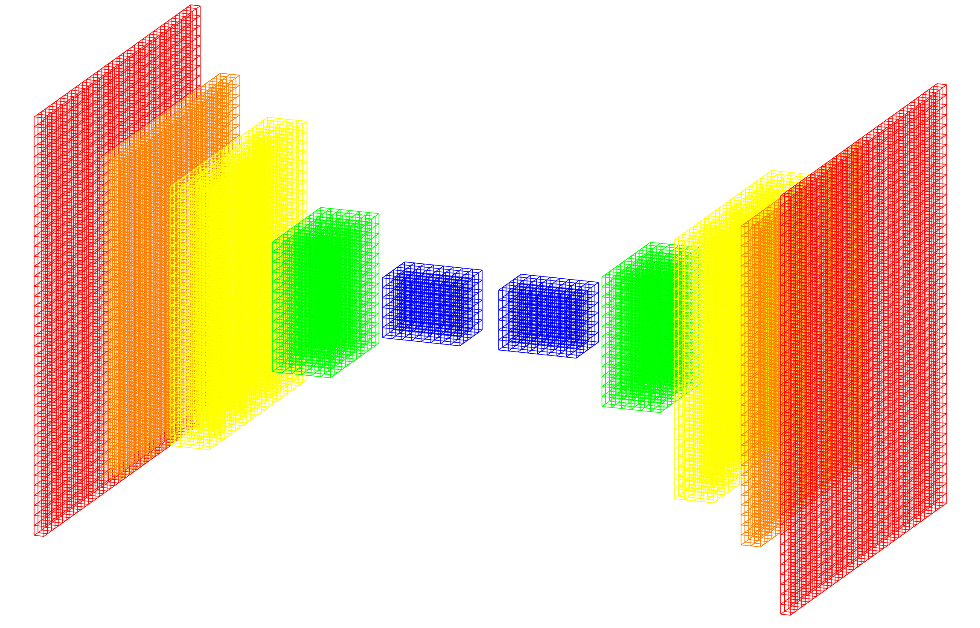
Image Processing – Solution
Deep Learning Model: U-Net
Training Data
Training
Data
Encoder
Decoder
Target
image
Output
image
errors
Back-propagation
Input image

Slide 32
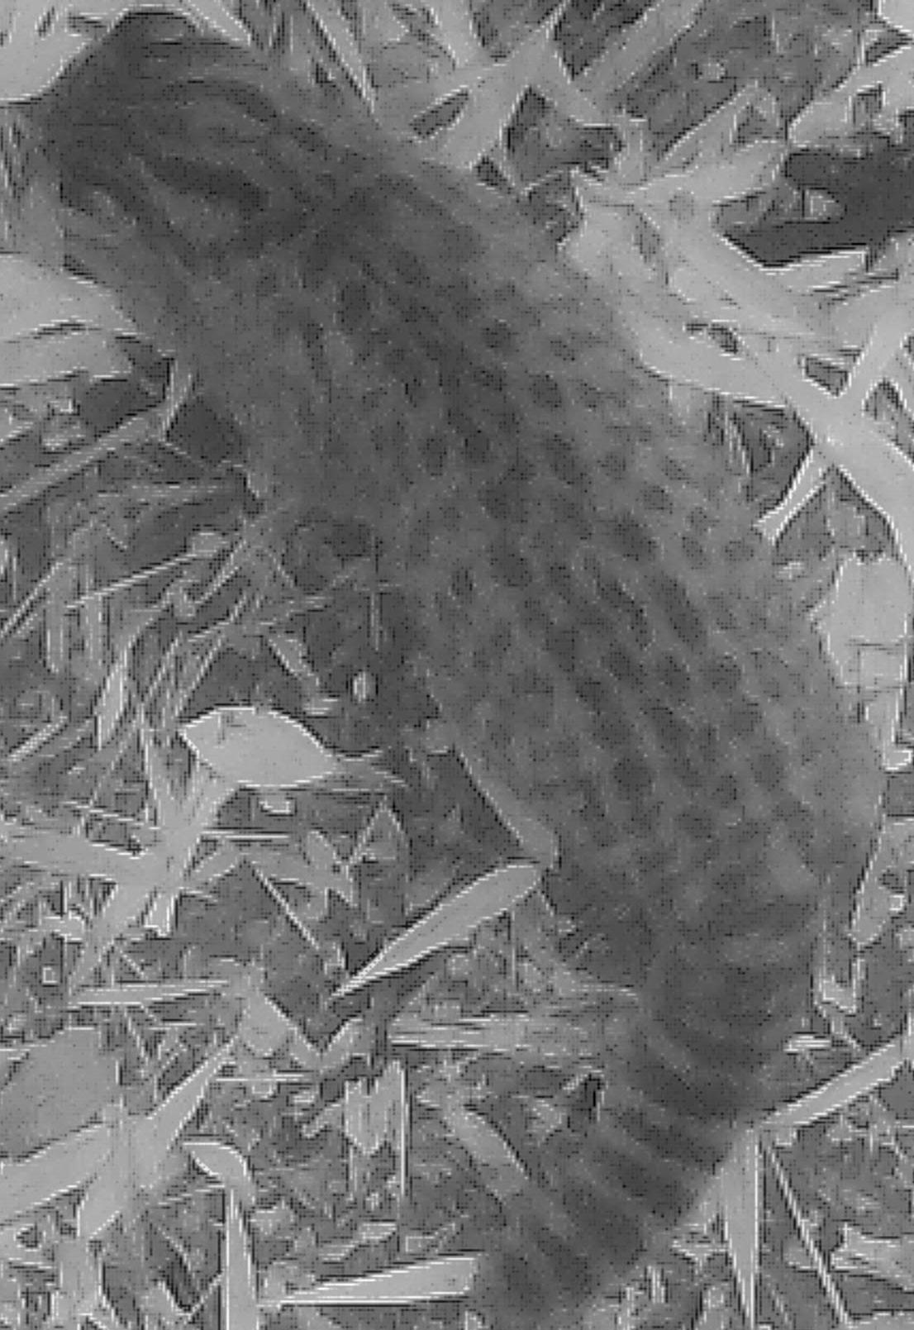
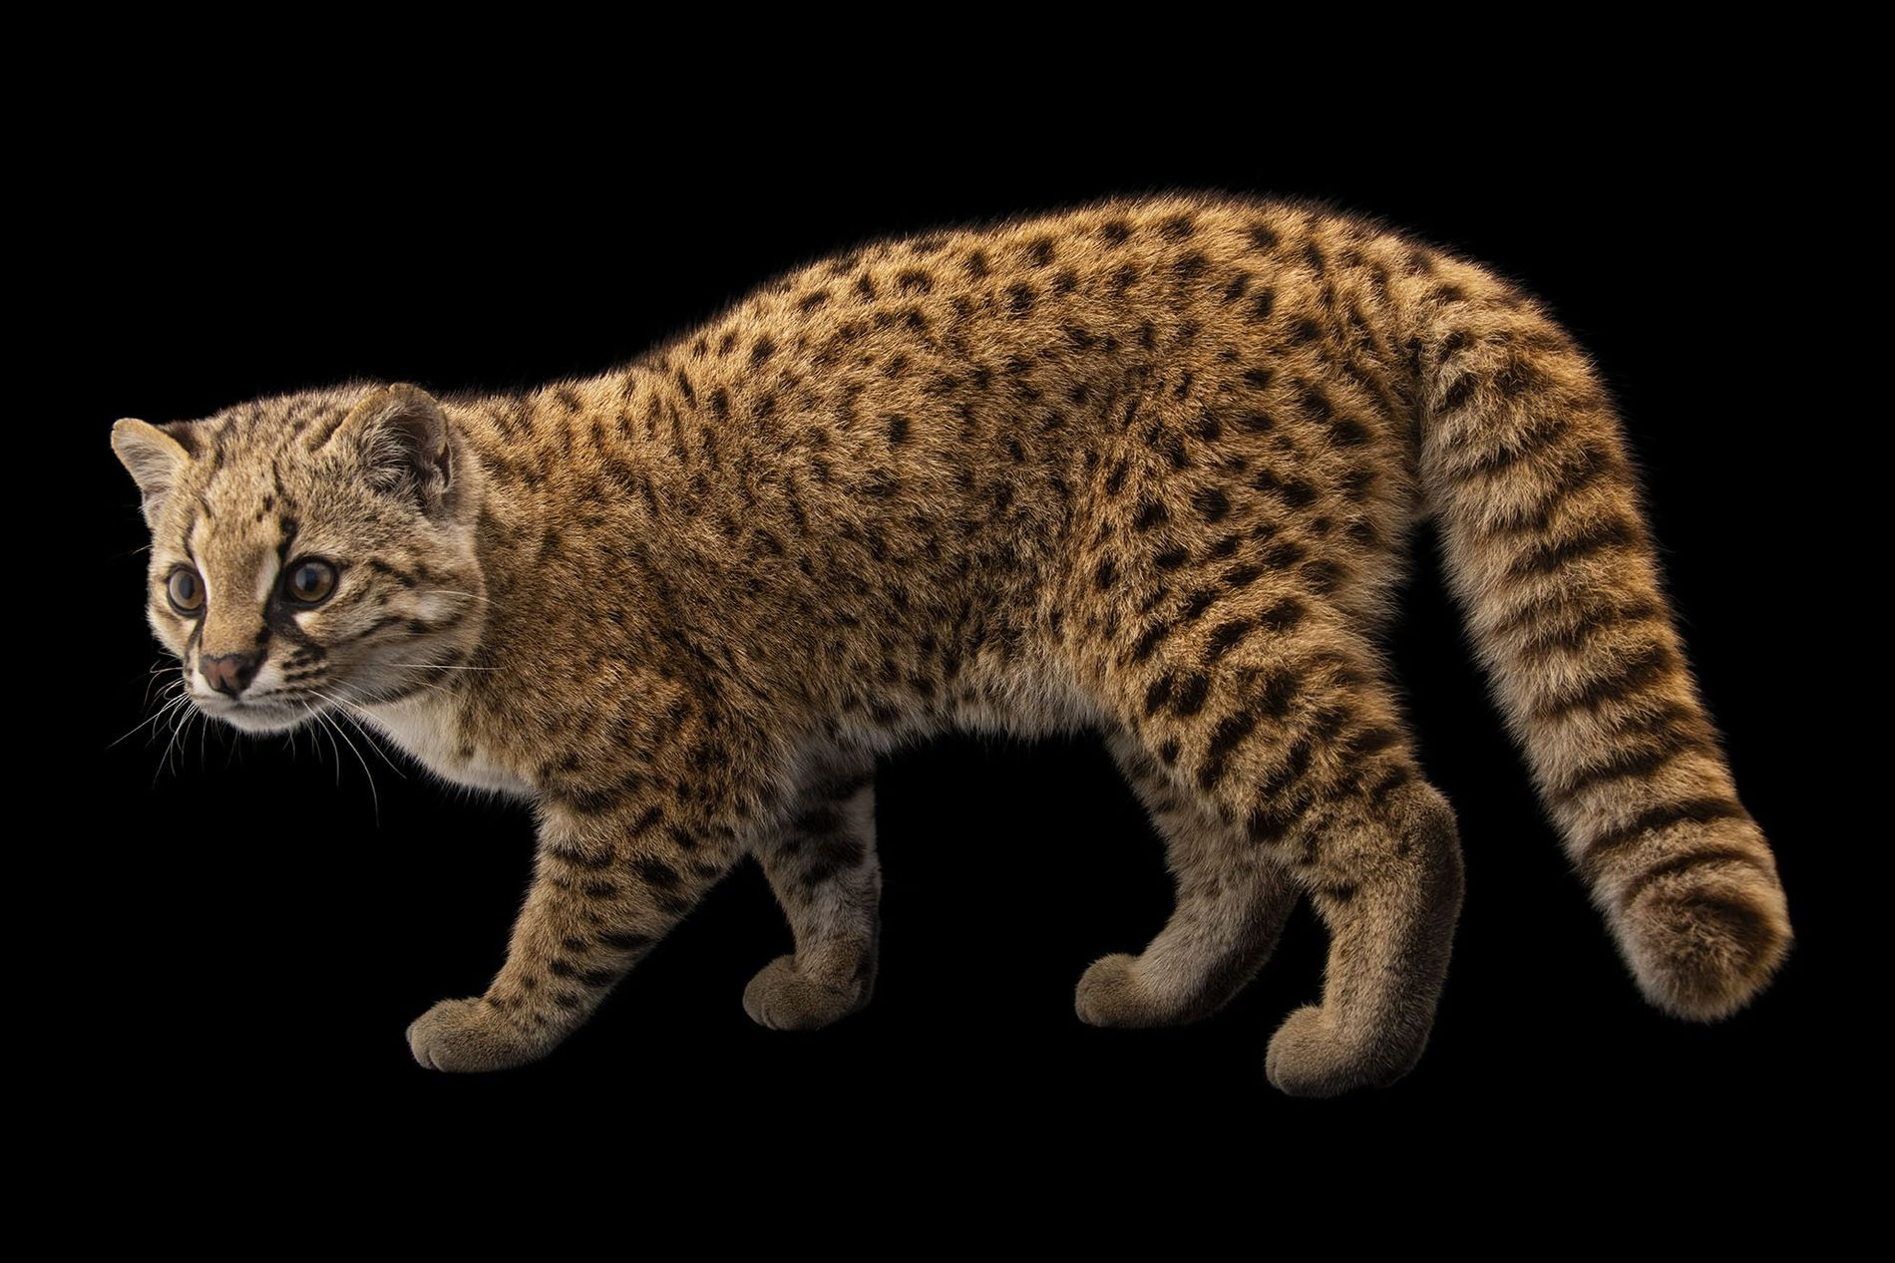
Image Segmentation
Example
Trap Camera
Segmentation
Güiñas
Segmentation

Slide 33
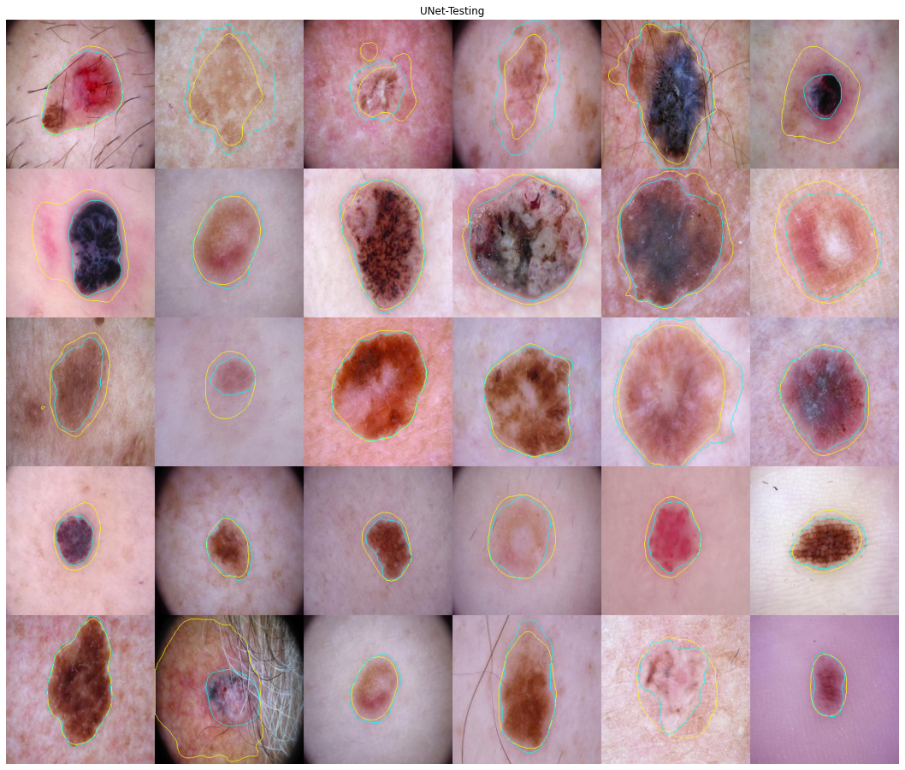
Image Segmentation
Example
Skin Lesion
Segmentation

Slide 34
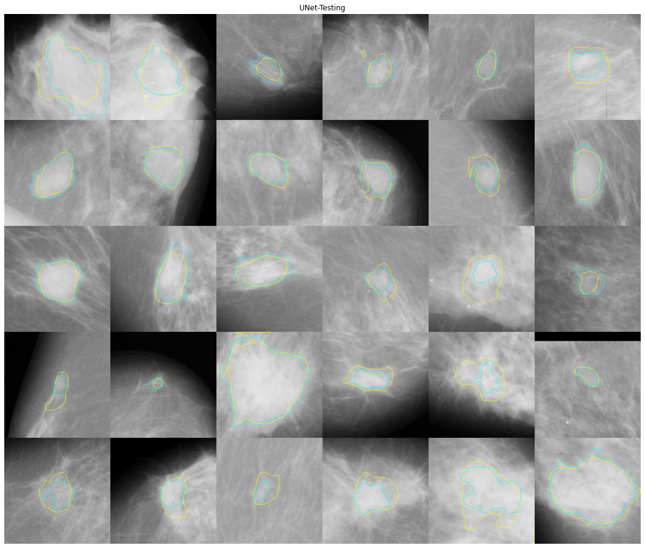
Image Segmentation
Example
Breast Tumor
Segmentation

Slide 35
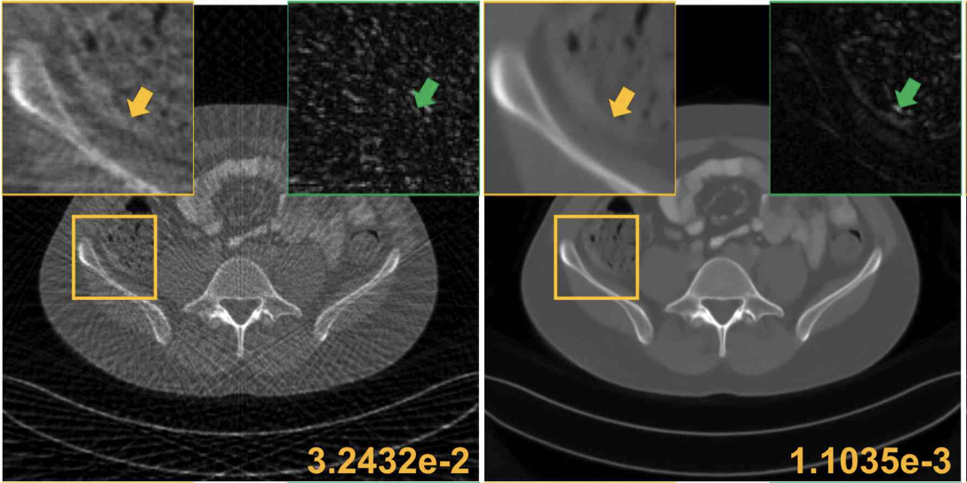
Image Denoising
Example
Input Output
MRI reconstruction
Han, Yoseob, and Jong Chul Ye. "Framing U-Net via deep convolutional framelets: Application to sparse-view CT." IEEE transactions on medical imaging 37.6 (2018): 1418-1429.

Slide 36
Applications of Computer Vision for Medicine
Applications
Image Classification
Image Processing
Object Detection
Anomaly Detection
Human + Computer Vision

Slide 37
Applications of Computer Vision
Applications
Image Classification
Image Processing
Object Detection
Anomaly Detection
Human + Computer Vision

Slide 38
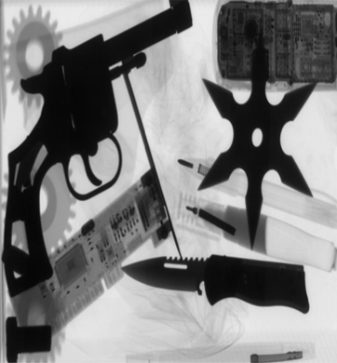
Object Detection – Problem
> Locate and classify objects
handgun
Object
Detection
shuriken
knife
Input: image
Output: Bounding Boxes + Classes

Slide 39
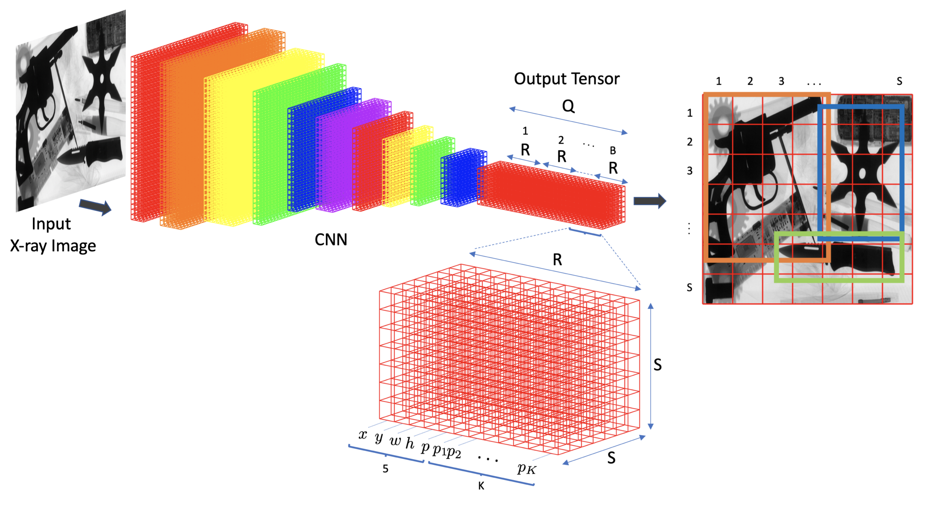
Object Detection – Solution
Deep Learning Model: YOLO

Slide 40
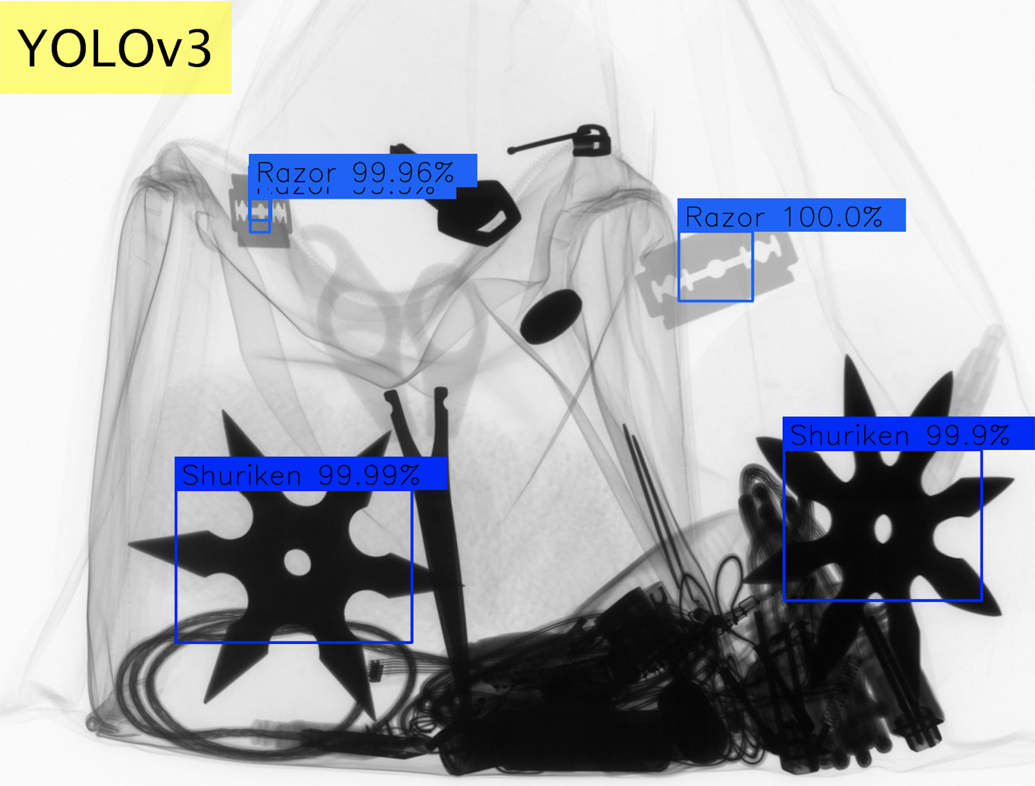
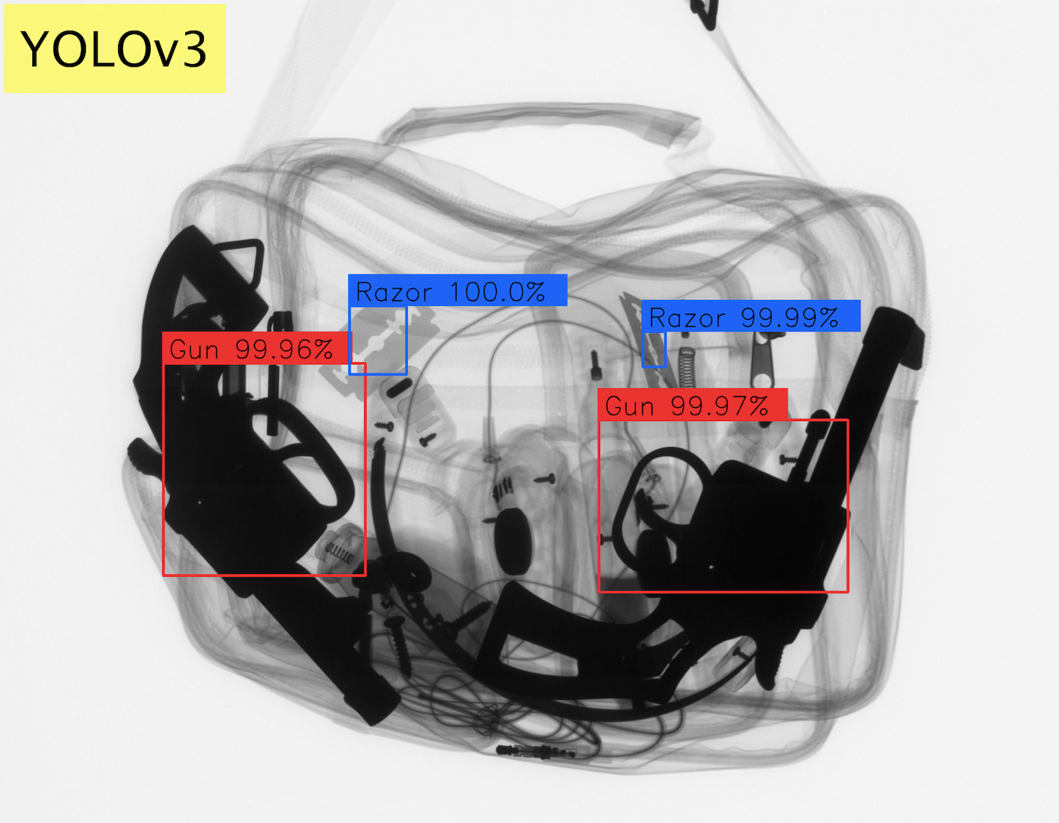
Object Detection – Example
Deep Learning Model: YOLO
Recognition of Threat Objects in Baggage Inspection

Slide 41
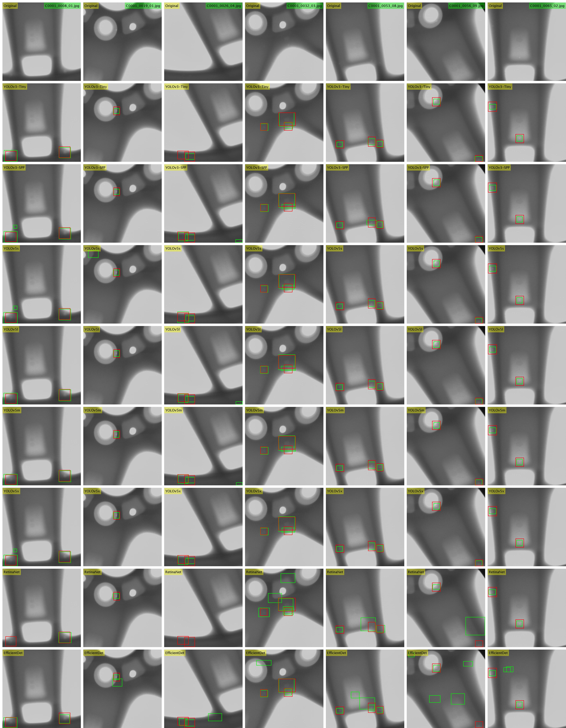
Object Detection – Example
Deep Learning Model: YOLO
Recognition of Small Defects in Aluminum Wheels

Slide 42
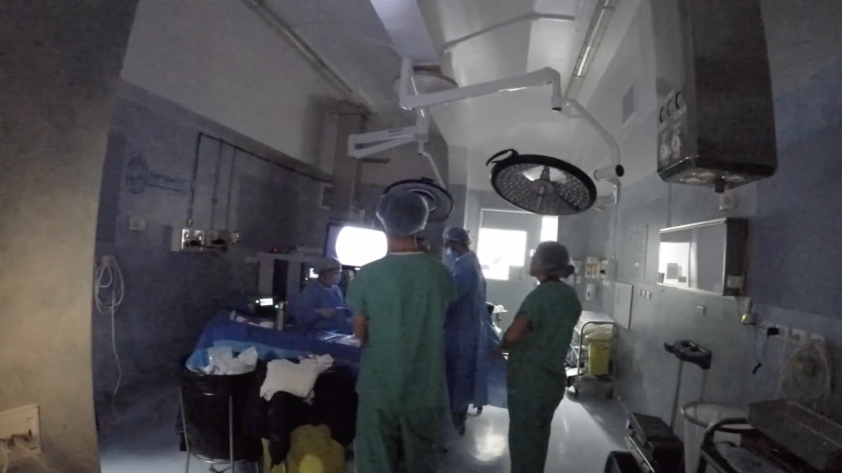
Object Detection – Example
Monitoring of Operating Rooms
Operating Room Management:
The idea is to maximize operational efficiency at the operating room:
Maximize the number of surgical cases
Minimize the resources and costs.
Notes:
Operating room management is the science of how to run an operating room suite. Operational operating room management focuses on maximizing operational efficiency at the facility, i.e. to maximize the number of surgical cases that can be done on a given day while minimizing the required resources and related costs.

Slide 43
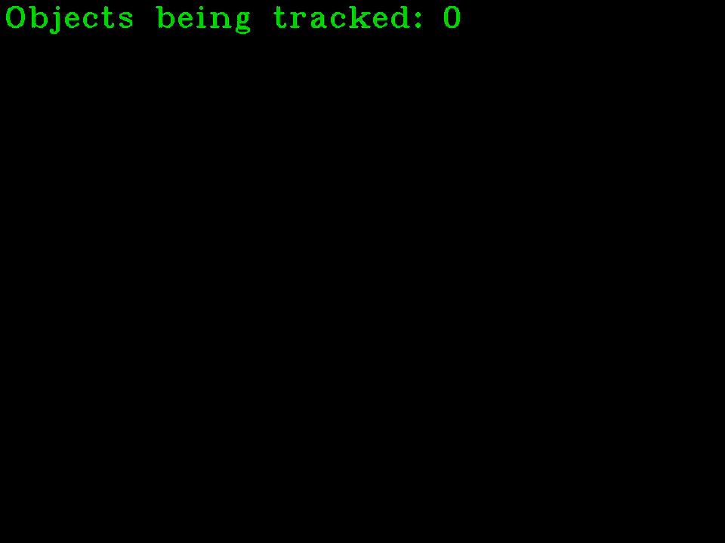
Object Detection – Example
Monitoring of Operating Rooms

Slide 44
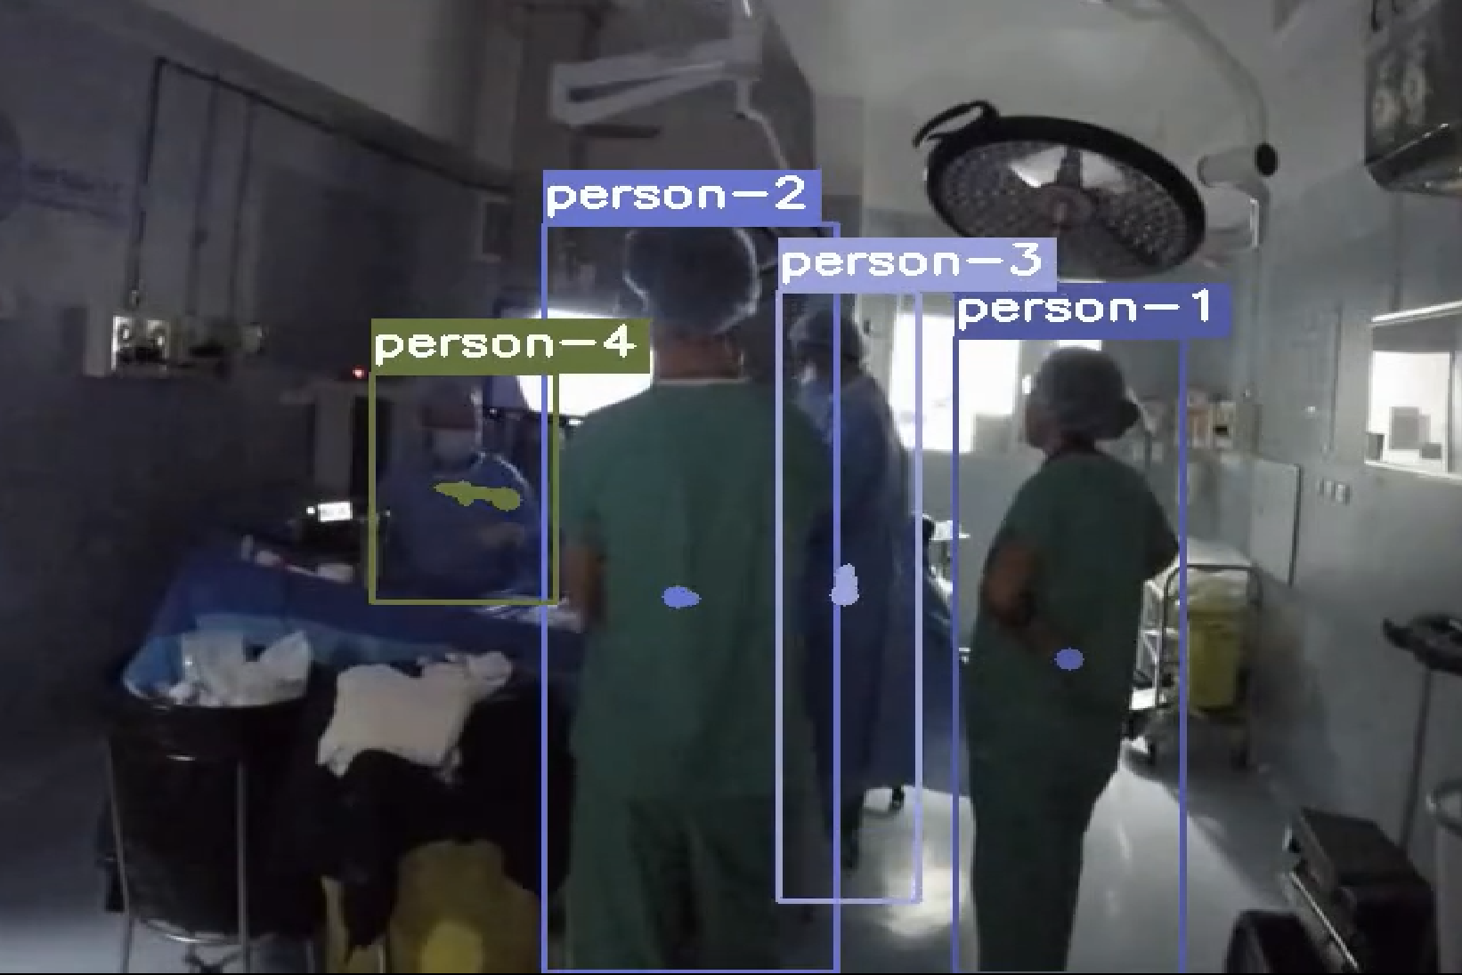
Object Detection – Example
Monitoring of Operating Rooms
ID
01
02
03
04
05
0:00 1:00 2:00 3:00 4:00 5:00 6:00 7:00 8:00 9:00 10:00

Slide 45
Applications of Computer Vision
Applications
Image Classification
Image Processing
Object Detection
Anomaly Detection
Human + Computer Vision

Slide 46
Applications of Computer Vision
Applications
Image Classification
Image Processing
Object Detection
Anomaly Detection
Human + Computer Vision

Slide 47
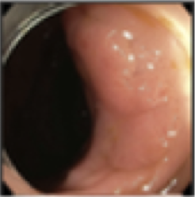
Anomaly Detection – Problem
> Detect an anomaly in an image
Anomaly
Detection
Input: image
Output: Detection

Slide 48

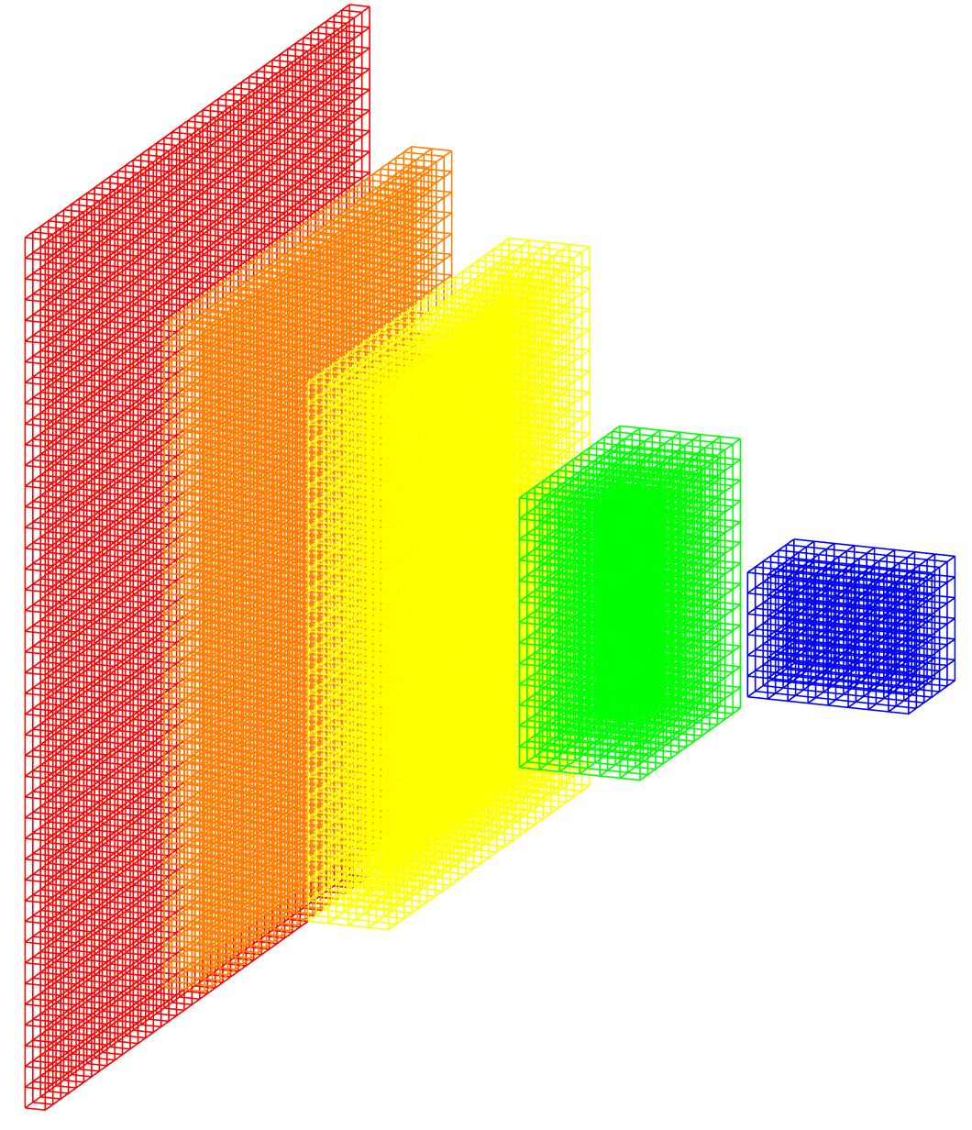
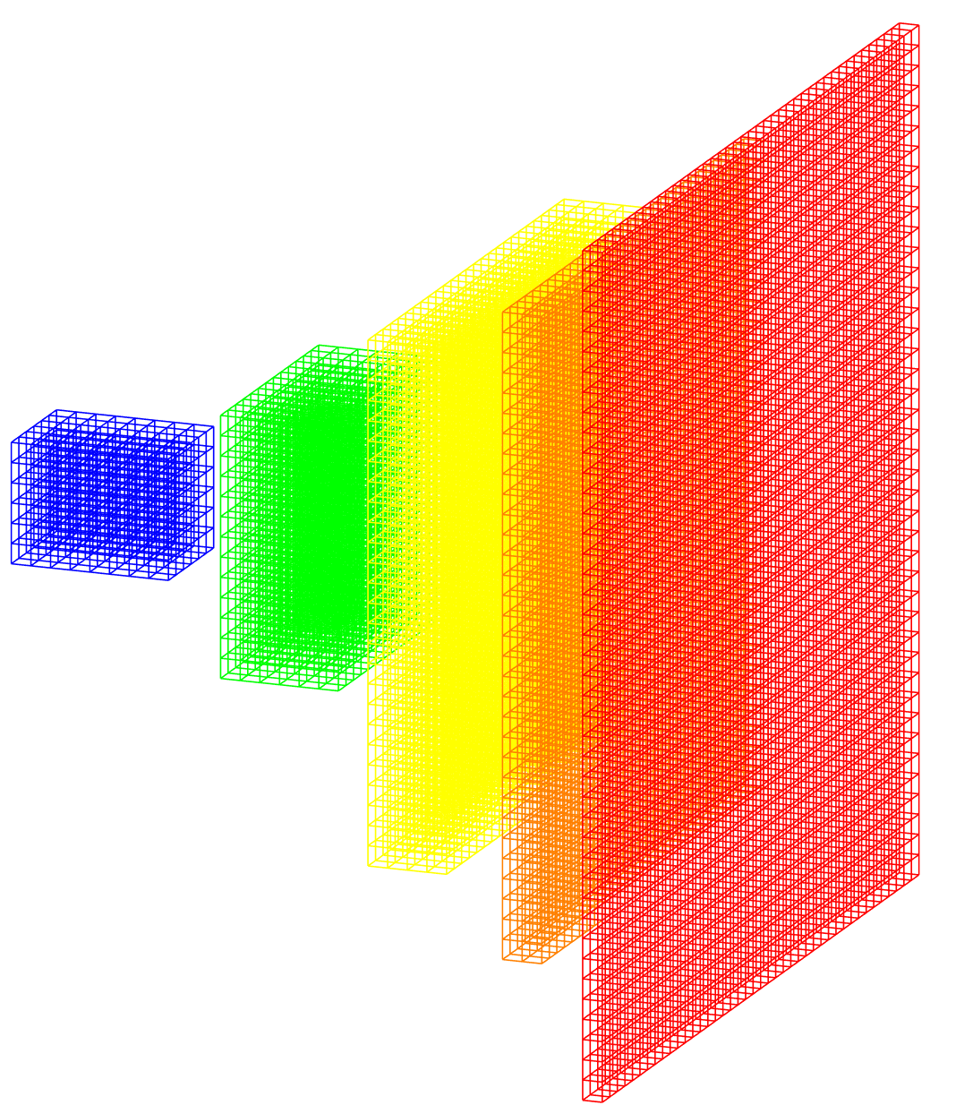
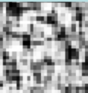
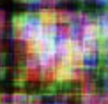
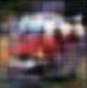
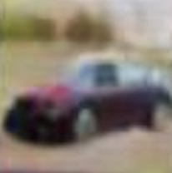
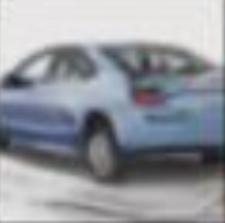
Anomaly Detection – Solution
Deep Learning Model: GAN
Generative Adversarial Network
Ground truth: real/fake
Real image
Discriminator
real/fake
Generator
error
Noise
Fake image
Iter = 1 500 10,000 50,000
error
Notes:
Zero-sum game theory

Slide 49
Anomaly Detection – Solution
Deep Learning Model: GAN
Generative Adversarial Network
Ground truth: real/fake
Real image
Discriminator
real/fake
Generator
error
Noise
Fake image
Iter = 1 500 10,000 50,000
error
Notes:
Zero-sum game theory

Slide 50


Anomaly Detection – Solution
Deep Learning Model: GAN
Generative Adversarial Network
Images without
anomalies
Ground truth: real/fake
Real image
Discriminator
real/fake
Generator
error
Noise
Fake image
error
Notes:
Zero-sum game theory

Slide 51
Anomaly Detection – Solution
Deep Learning Model: GAN
Generative Adversarial Network
Images without
anomalies
Ground truth: real/fake
Real image
Discriminator
real/fake
Generator
error
Noise
Fake image
error
Notes:
Zero-sum game theory

Slide 52

Anomaly Detection – Solution
Deep Learning Model: GAN
Generative Adversarial Network
Images without
anomalies
Encoder
Generator
Notes:
Zero-sum game theory

Slide 53
Anomaly Detection – Solution
Deep Learning Model: GAN
Generative Adversarial Network
Images without
anomalies
Encoder
Generator
error
Notes:
Zero-sum game theory

Slide 54
Anomaly Detection – Solution
Deep Learning Model: GAN
Generative Adversarial Network
Real Image
with anomaly
Encoder
Generator
Synthetic image
without anomaly
Anomalies
Notes:
Zero-sum game theory

Slide 55

Anomaly Detection – Example
Colonoscopy video frames
Liu, Yuyuan, et al. "Photoshopping colonoscopy video frames." 2020 IEEE 17th International Symposium on Biomedical Imaging (ISBI). IEEE, 2020.

Slide 56

Anomaly Detection – Example
Retinal OCT images
Schlegl, Thomas, et al. "f-AnoGAN: Fast unsupervised anomaly detection with generative adversarial networks." Medical image analysis 54 (2019): 30-44.

Slide 57
Applications of Computer Vision
Applications
Image Classification
Image Processing
Object Detection
Anomaly Detection
Human + Computer Vision

Slide 58
Applications of Computer Vision
Applications
Image Classification
Image Processing
Object Detection
Anomaly Detection
Human + Computer Vision

Slide 59



Human + Computer Vision – Problem
> How can Human Vision and Computer Vision work in collaboration?
Computer Vision
Interpretation
Input: image
Human Vision

Slide 60



Human + Computer Vision – Example in Face Recognition
Face Recognition in Challenging Images
Is the same person?
No
No

Slide 61







Human + Computer Vision – Example in Face Recognition
Face Recognition in Challenging Images
Is the same person?
mmm…
maybe

Slide 62







Human + Computer Vision – Example in Face Recognition
Face Recognition in Challenging Images
Yes!

Slide 63



Human + Computer Vision – Example in Face Recognition
Face Recognition in Challenging Images
Is the same person?
Where do you see when recognizing a face?
Which regions are more relevant for AI?

Slide 64
Human + Computer Vision – Example in Face Recognition
Face Recognition in Challenging Images
We can include an attention map in the deep learning model to improve the performance.

Slide 65

Example in Skin Lesion Classification
Face Recognition in Challenging Images
Zhang, Jianpeng, et al. "Attention residual learning for skin lesion classification." IEEE transactions on medical imaging 38.9 (2019): 2092-2103.

Slide 66
Applications of Computer Vision
Applications
Image Classification
Image Processing
Object Detection
Anomaly Detection
Human + Computer Vision

Slide 67
Applications of Computer Vision
Applications
Image Classification
Image Processing
Object Detection
Anomaly Detection
Human + Computer Vision

Slide 68
Algoritmos de Deep Learning del Curso
Face detection
Face recognition
Face restoration
Age recognition
Gender recognition
Expression recognition
Soft attributes
Face clustering
Pose estimation
Explainability
Object Classification (CNN)
Object Detection (YOLO)
Tracking
Segmentation (UNet)
GAN
Anomaly Detection
Transformers
Facial Analysis

